Slide 1
An Introduction to Autistic Spectrum Conditions (ASC) – Level 2
Dr Tom Connor

Slide 2

PRAISE Approach
Proactive vs. Reactive
95% of successful behaviour management is preventing negative behaviour

Slide 3
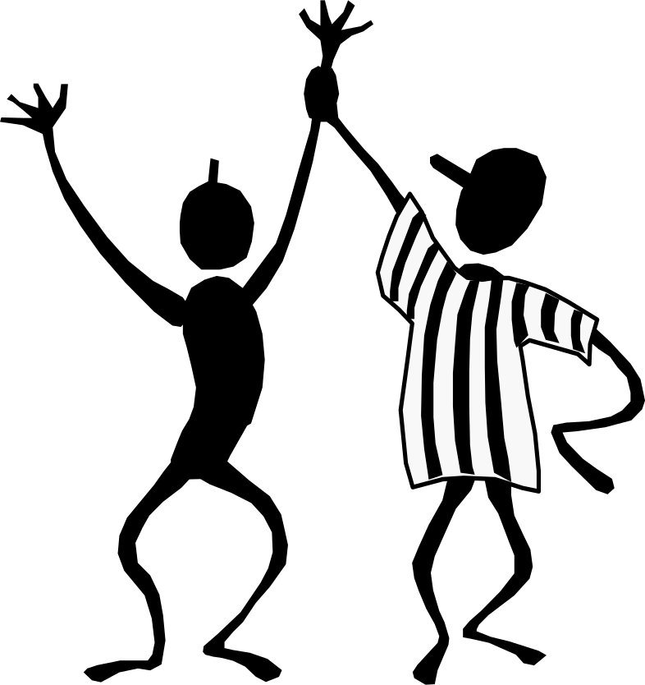
Proactive
Be Positive
Be Fun
Be Structured
Be Consistent
Be Fair
Set Effective Limits
(See part #1 behaviour strategies)

Slide 4
Proactive
Reinforcements
Reinforcements –
Always start with the least restrictive reinforcement…

Slide 5
Reinforcements
Positive (Always)
Positive words
Positive calls home
Social reinforcements
Behaviour contracts
Points/levels system
Token economy
Negative (Sometimes… why?
Verbal reprimands, frowns, reminders, etc.
Physical proximity
In class consequences
Imposing in-class separation (time out)
Removal from classroom
Send home (never!)
See part #2 Behaviour analysis

Slide 6

Proactive
Reinforcements
Assess the situation
What are my own barriers??
What is preventing positive behaviour from occurring
See part #3 ABC and STAR

Slide 7

Assess the situation
A B C
Antecedent
Behavior
Consequence

Slide 8
Proactive
Reinforcements
Assess the situation
Intent of misbehavior
Intent of misbehavior
…Why do students misbehave?

Slide 9

Intent of misbehavior
Attention
Power
Revenge
Display of Inadequacy
Testing of Limits
See part #4 communication and Functional Behaviour Assessment

Slide 10
Proactive
Reinforcements
Assess the situation
Intent of misbehavior
Sincerity

Slide 11

Sincerity
Compassion
Acknowledgement
Reassurance
Esteem
See part ~5 Emotional Literacy

Slide 12
Proactive
Reinforcements
Assess the situation
Intent of misbehavior
Sincerity
Empower the child

Slide 13

Empower the child
Encourage self-talking and questioning
Our goal is not to manage children’s behaviour, but rather to teach children to successfully manage their own behaviour
What we are asking students is really to behave abnormally
(Rational responses to irrational situations …
See part #6 b=f(p/s)

Slide 14
Introduction: Reminding ourselves… What is Autism?
“Autism is a lifelong developmental disability that affects how a person communicates with, and relates to, other people. It also affects how they make sense of the world around them.”
(NAS, accessed September 2015)

Slide 15
ASC traits
Many individuals with an ASC have other traits, including differences in sensory processing
Each person with an ASC is an individual with areas of strength and weaknesses – just like all of us
“The neurotypical cave dwellers may have enjoyed partying in the cave mouth, but we also owe something to the person who persisted in banging the stones together at the back of the cave”
(Derbyshire File for Autism Friendly Schools)

Slide 16
The Triad of Impairments
Social Interaction
Social relationship difficulties
Appreciation of the social uses of language
Difficulty in the development of play and imagination
Social Imagination /
(In)Flexibility of thought
Social
Communication

Slide 17
ASC Strengths include…
An unusually good memory for facts
A focus on a narrow range of interests, meaning they are well informed on some topics
Skills in ICT, Maths, Science, technology
A determination to complete tasks to a high standard
Complying with rules (e.g. punctuality)
Honesty – even at the cost of social popularity

Slide 18
Part 1: Positive Behaviour Approaches
Theoretical Approaches that help us to understand (and react accordingly):
Theory of Mind
Central Coherence
And also:
Executive Functioning

Slide 19
Theory of Mind
“The ability to infer other people’s mental state (their thoughts, beliefs, intentions, etc.) and the ability to use this information to interpret what they say, make sense of their behaviour and predict what they will do next”
… The ‘Sally – Anne’ test

Slide 20
Theory of Mind
Portrayed by:
  Insensitivity to other people’s feelings.
  Inability to take into account what other people know.
  Inability to understand the reasons behind people’s actions.
  Inability to understand that language is used to convey intentions and express thoughts.
  Inability to predict what will happen next.
  Inability to deceive or understand deception.

Slide 21
Central Coherence
“The ability to integrate information in context”
“The ability to see the big picture, as opposed to getting lost in the smaller detail”

Slide 22
Central Coherence
“A clinician testing a bright autistic boy presented him with a toy bed, and asked the child to name the parts. The child correctly labelled the bed, mattress and quilt. The clinician then pointed to the pillow and asked “ And what is this?” The boy replied, “It’s a piece of ravioli”.”

Slide 23
ASC – Intervention and Labelling risks?
The label may be the same, but the precise nature of the children’s strengths and needs, and their familial or educational or environmental circumstances, can still be significantly different … as can the responses to an intervention.
Connor (2008)

Slide 24
How are behaviours learned?
Learning implies that a behaviour is added to an individual’s repertoire in a relatively permanent way (Catania, 1990).
One can learn skills such as addition and subtraction, or behaviours such as brushing teeth or washing hands.
One can also learn challenging behaviours such as head banging or endlessly talking about subjects that others may not be interested in!
Once one understands how behaviours are learned then one can start to appreciate why behaviours occur when they do.
Implication for ASC: Less likely to learn incidentally or through inference
Notes:
Intro to ABA 2 & 3 July 2009

Slide 25
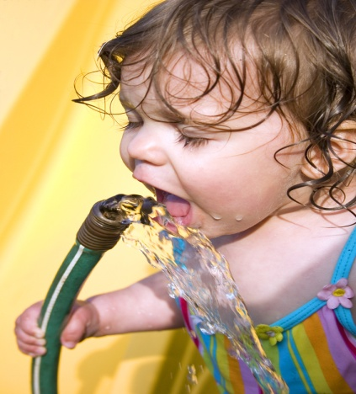

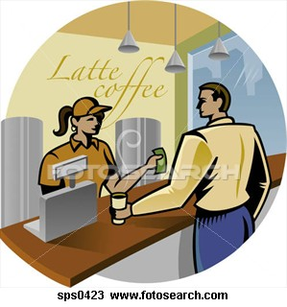

The components of learning
Motivation Antecedent Behaviour Consequence
Motivation + Antecedent + Behaviour + Consequence
= LEARNING

Slide 26
How are behaviours learned?
Motivation + Antecedent + Behaviour + Consequence = LEARNING
Motivation – what a person wants
Antecedent – what happens before a behaviour
Behaviour – the actual response
Consequence – the result of a behaviour
Notes:
Intro to ABA 2 & 3 July 2009

Slide 27
How is behaviour learned?
Consequence – what happens as a result of the behaviour of interest
  Reinforcement
  Punishment
  Neutral
Although a consequence comes chronologically at the end of a learning sequence, the concepts relevant to consequences are important to help develop an understanding of motivation, antecedent and behaviour.

Slide 28
Consequences
Reinforcement
★
What is reinforcement? Your thoughts – fill in and give examples on the spider diagram in your resource packs
Reinforcement involves consequences that ‘strengthen a behaviour’
To ‘strengthen a behaviour’ means to increase the likelihood that it will occur again in the future.
Notes:
Intro to ABA 2 & 3 July 2009

Slide 29
Consequences
Reinforcement
  Definition:
  “Any stimulus which when delivered contingently on a response, increases the future probability of that response occurring again.”
  (Cooper, Heron & Heward, 2007)

Slide 30
Positive Reinforcement
Definition:
  Any stimulus that, when added contingently on a response, serves to increase that response.
Real life examples:
Child asks politely for a drink
Pupil puts up hand in class
Telling a joke
Notes:
Intro to ABA 2 & 3 July 2009
Explain example.
Ask audience:
What is the difference between positive and negative? (given Vs removed)

Slide 31
Negative Reinforcement
Definition:
  Any stimulus that, when removed contingently on a response, serves to increase that response.
Real life examples:
Closing the window on cold day
Adjusting the hot water in the shower
Removing a pair of tight shoes
Turning down the volume on the TV
Sitting outside the head teacher’s office (?)
Notes:
Intro to ABA 2 & 3 July 2009
Explain example.
Ask audience:
What is the difference between positive and negative? (given Vs removed)

Slide 32
Positive Vs Negative Reinforcement
Positive means: | Negative means:
Adding something that was not present to the situation – result is increase in behaviour | Taking away something that was already present in the situation – result is increase in behaviour
NB. Negative reinforcement does not mean the same as punishment
Notes:
Intro to ABA 2 & 3 July 2009
Reinforces last slides
Stresses that both are reinforcement and will increase behaviour.
Negative Reinforcement is not punishment

Slide 33
Consequences
Reinforcement
Examples:
A man being told that a bow tie looks nice on him, resulting in his wearing the dress more often.
A child being given £1 for cleaning her room, resulting in her cleaning it every day!
An infant discovering that his mobile will shake around if he kicks, resulting in him kicking his legs more frequently.
Notes:
Intro to ABA 2 & 3 July 2009

Slide 34
Consequences
Reinforcement: The aim…
When working with any learner, the aim is to move towards the use of naturally occurring reinforcers:
  E.g.:
  Task completion (usually pleasurable?)
  praise
  school/ society-based systems of reward (e.g. token systems)

Slide 35
Motivation
MO + A + B + C = LEARNING
What a person wants or desires and how hard he is willing to work to get it.
Motivation drives behaviour, therefore, we need to control and measure it to change behaviour.
E.g. thirst - Teaching the verbal request for “juice”.
To do this, child must want juice, juice must act as reinforcer. If child has just consumed two large glasses of juice it is unlikely that you will able to set the occasion for this request to occur again at this time.
If child hasn’t had a drink for the past hour, juice is much more likely to be reinforcing and motivation will be higher for child to engage in target behaviour and ask for ‘juice’
Notes:
Intro to ABA 2 & 3 July 2009
Examples
Teaching the verbal request for “juice”. To do this child must want juice, juice must act as reinforcer. If child has just consumed two large glasses of juice it is unlikely that you will able to set the occasion for this request to occur again at this time.
Teaching the verbal request for “juice” – if child hasn’t had a drink for the past hour, juice is much more likely to be reinforcing and motivation will be higher for child to engage in target behaviour and ask for ‘juice’

Slide 36
Motivation
So…
Reinforcement depends on motivation
The antecedent will only signal the response if the individual is motivated to engage in the response
The more you are deprived of something desired, the more you want it. You will try behaviours that have worked in the past to get it, and getting what you want will strengthen the behaviour that worked. (Tantrum example?)
The more you have of something, the less you want it. So you will not engage in behaviours to get it.

Slide 37
Typical naturally occurring motivators
Thirst
Hunger
Tiredness (related to sleep)
Activity levels
Air quality and how it affects breathing
Temperature changes (heat, cold)
Pain

Slide 38

Iceberg model – understanding individual behaviour
The behaviour that we see is just the tip of the iceberg….we need to look below the surface to understand what the behaviour is telling us … and what the child may be trying to communicate.
…Visible
… Invisible
Notes:
The author Philip Whitaker suggests thinking of behaviour as an iceberg: the behaviour you are actually seeing is the tip of the iceberg but there's a lot more going on under the surface (Whitaker, 2001). People with an ASD can't always express their feelings through facial expressions, body language or speech. Instead, they may be expressed through other behaviours. Your child might be trying to tell you they are tired, stressed, annoyed by something that happened earlier, or in need of some time alone.

Slide 39
SETTINGS:
Environmental or personal
RESULTS:
What happens-
for the child?
STAR
TRIGGERS:
What sets it off?
ACTION:
Observable behaviour

Slide 40
Antecedents, Behaviours and Consequences
An antecedent is an environmental condition or a change to the environment that occurs directly before the behaviour of interest.
MO + A + B + C = LEARNING

Slide 41
Behaviour
What is ‘behaviour’?
The activity of living organisms (the “dead person” test)
Anything and everything that a person does
MO + A + B + C = LEARNING

Slide 42
Scene 1
A child paces the living room of his home. He repeatedly slaps himself in the face. Periodically, he vigorously bangs his head against the wall.
In the self-injury situation, the person might have been protesting an unexpected change in his daily activity schedule. He was expecting to go out to eat. No one remembered to tell him in advance that the activity was postponed until tomorrow. To put it mildly, he is upset and disappointed.

Slide 43
Scene 2
A middle aged man in a workshop for people with disabilities sits working at an assembly task. Suddenly, he angrily begins to throw the assembly parts around the room.
In the throwing of materials situation, the person might be communicating: (a) boredom with the task at hand, and (b) the need for a break. Because of an inability to talk, this man cannot tell anyone in a direct fashion how bored he is with doing the same task day after day. He needs a break, but, more importantly, he needs a greater variety of challenging tasks to fill his day.

Slide 44
Scene 3
A secondary school child sits in a classroom with 30 other children. After sitting passively for 10 minutes, he deliberately puts his head down on his desk. He steadfastly refuses to begin his schoolwork.
In the non-compliance situation, the child might be confused about the assignment and needs help or an explanation. He may have been unable to process all of the spoken instructions when they were given to the class ten minutes ago. Now he does not know what to do and feels he is a failure.

Slide 45
Implications
Some people with autism cannot speak. Others:
(a) may have some ability to talk, but may have limited skills (remember Raymond in Rain Man?)
(b) may become inarticulate and not be able to use their skills when they are in a distressing situation
(c) may freeze and not be able to find or retrieve the right words to clearly express their message when they are under stress.

Slide 46
Behaviour as communication
Instead, people with autism often use a means of communicating that is immediate and effective, i.e. negative behaviours. A negative behaviour almost certainly will get someone's attention.
It also may quickly achieve the desired intent. The person with autism may have learned the effectiveness of a given negative behaviour when more subtle communicative messages were ignored. For example, in the wanting-a-break situation (scene #2), the following may have occurred:

Slide 47
Why do we communicate?
Examples might include:
  To respond to someone else (“yes please”)
  To request something we need (“a drink”)
  To protest, refuse or complain (“no!”)
  To think and plan (“I think we should…”)
  To comment on something (“nice shirt, Tom”)
  To give or seek information (“who are you?”
  To share ideas or feelings (“I feel sad”)

Slide 48
Behaviour interventions
A major component of any behaviour plan involves teaching the person with autism a socially acceptable way of communicating a message.
This means giving the person the power to communicate in a better way. Punishment will not teach positive skills.
Instead, punishment may ensure that the behaviour occurs again. For example, the next time the person wants a break, he may immediately throw materials. Why shouldn't he do this? After all, the negative behaviour previously got him the desired outcome.
We all tend to use behaviours that work effectively.

Slide 49
Behaviour Plans – Implications
Ask yourself these questions after a behavioural incident:
What might the person really be communicating?
What other means could the person have used to give you the same message?
Would a communication board or picture message board have helped?
How could you become involved in teaching him/her better ways to communicate?

Slide 50
The ABC Model (1)
A – Antecedents (what happens immediately before … and might not be obvious)
B – Behaviour (what exactly happens … When … How often)
C – Consequences (what is the result of the behaviour, direct or in-direct)

Slide 51
Matching Law
B1 = V1
B2 = V2
Notes:
B = Behaviour
V = Values

Slide 52
So what does it all mean?
What we are trying to teach is different values of behaviour.
We know that an individual ‘values’ the things that they do and the function of those behaviours e.g. Requesting a drink when thirsty.
Equally not responding to an instruction or pulling someone's hair to escape or avoid a demand, will be a valuable behaviour relating to the function of the behaviour.
We also know that an individual may have never learnt an alternative way of saying they don’t want to do something!

Slide 53
Change the value of the behaviour…
...and you change which behaviour the individual will use to get what they want:
E.g.:
B1= Throw a book to avoid reading
Vs.
B2= Using a break card to have a 2 minute rest
Teaching someone to use a break card and allowing that
break each time they ask will increase the value of B2 and
B1 will diminish over time.

Slide 54
Implications
Managing behaviour in this way requires:
A shared, consistent approach
Faith
A positive attitude (i.e. a belief that it is going to work, and not that it is going to fail)
Going across environments/ contexts
Perseverance (see the Change Curve or the Behaviour Response Cycle as a reminder of how situations can get worse before they get better)

Slide 55
Part 5: Sincerity
Takes us back to the NAS definition:
“Autism is a lifelong developmental disability that affects how a person communicates with, and relates to, other people. It also affects how they make sense of the world around them.”

Slide 56
Part 6: Empower the Child
Taking it back to basics…
Behaviour Monitoring
Kurt Lewin (1935)
“B = f (P, E)”
Notes:
Mathematical equation which helps us to understand the purpose of a behaviour.
We must identify and understand each part of the equation

Slide 57
Behaviour is the Function of Personality and Environment
B: the individual's observable behaviour…. And behaviour as communication, therefore, always in some way directed toward another person.
P: all the causal factors that reside within the individual child – cognitive, emotional and motivational states, as well as traits, attitudes, and other behavioural dispositions.
And E: All the causal factors that reside in the world outside the individual (everything else! E.g. presence of others, social structure, roles, heat, volume …)

Slide 58
Kurt Lewin
"A successful individual typically sets his next goal somewhat but not too much above his last achievement. In this way he steadily raises his level of aspiration."

Slide 59
“B”
Behaviour:
What do we actually see? Who sees it?
How often does it happen?
Where does it happen?
What does it tell us? How do we know?
Notes:
Overcoming prejudice
“He’s always like this”
What else does “he” do … What about the exceptions … In which situtions does this not occur?

Slide 60
“P”
The Person (within-child factors)
“Personality traits” can be used to predict behaviour in some situations, but this is not exclusive
What else?
What do we already know?
What support / interventions are in place? What effect are these having?
Notes:
Which may include cognitive / communication / language difficulties etc
Does the child understand the task? The language? Etc
Are interventions in place appropriate … after all we know that an intervention is useless if it doesn’t work for that particular child.

Slide 61
“E”
Environment:
What else is going on?
Observations
Hypothesis testing
Assessment
Notes:
What about the interaction between the child and the adult …
Language?
Relationship?
Appropriateness of support?
Contextual factors … what else might affect the child’s capacity to engage successfully?

Slide 62
Golden Rules
Understand the autism
Analyse the behaviour
Use structure
Rather than trying to change the child or the autism! Try changing yourself /communication
Reduce anxiety
Be consistent
Plan transitions

